Slide 1
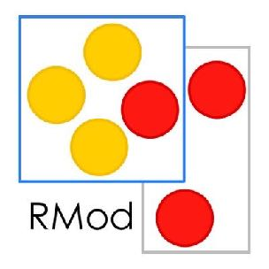

Blockchain & Smart Contracts Crash Course
Santiago Bragagnolo (santiago.bragagnolo@inria.fr)

Slide 2
About Me
Santiago Bragagnolo(santiago.bragagnolo@inria.fr)
Ph.D. Student on Software Migration
Research Engineer at Inria Lille (France, 2015 – 2020)
Working on blockchain since 2016
Working in engineering since 2002

Slide 3
Summary (1st part)
Introduction
General Structure
Mining
Smart Contracts
Some contributions from our team

Slide 4
Introduction

Slide 6
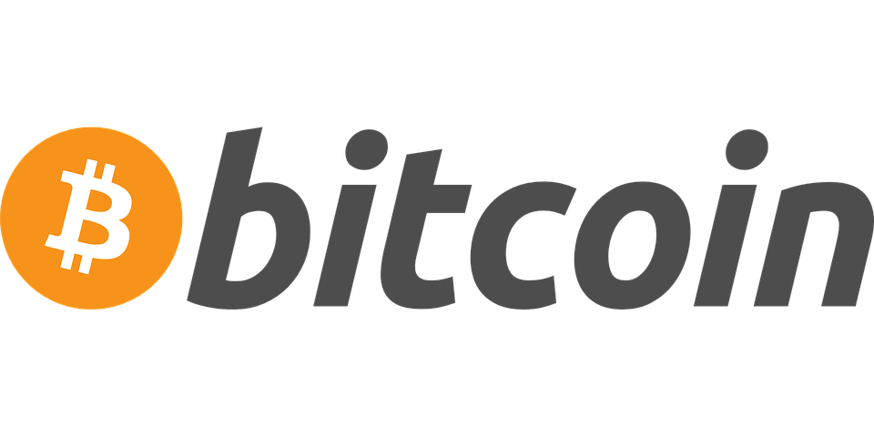
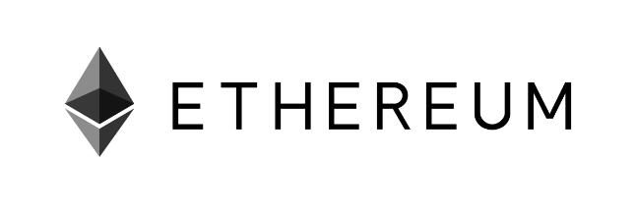
What is Blockchain?
Examples of Blockchain Technologies

Slide 7
What is Blockchain?
From an User’s Perspective
An open distributed Ledger

Slide 8
What is Blockchain?
From an User’s Perspective
An open distributed Ledger
Ledger - Records transactions (BitCoin, Ether).
Open - anyone can participate
Distributed - shared and synchronized among several “people”

Slide 9
What is Blockchain?
From a Developer’s Perspective
Roughly, an append-only distributed transactional database

Slide 10
What is Blockchain?
From a Developer’s Perspective
Roughly, an append-only distributed transactional database
Database
Transaction
Append-only
Distributed

Slide 11
Structure

Slide 12
Account
We need an account to interact with the blockchain
Roughly, an account’s id/address is a public key and whoever holds the private key owns it.
For example see: <https://etherscan.io/accounts>

Slide 13
Transactions
A transaction is an operation that changes something on the blockchain.
The information on transactions is public to everyone on the blockchain.
T.hash | From | To | Value
0x01… | 0xFA… | 0x9E… | 25
0x22… | 0x9E… | 0x2F… | 0
0xC3… | 0x9E… | 0x77… | 7

Slide 14
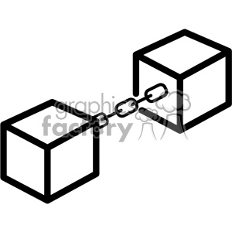
Blocks
A block is storage unit in the blockchain database
Transactions are bundled into a block
Is linked to the previous block
It contains a timestamp

Slide 15
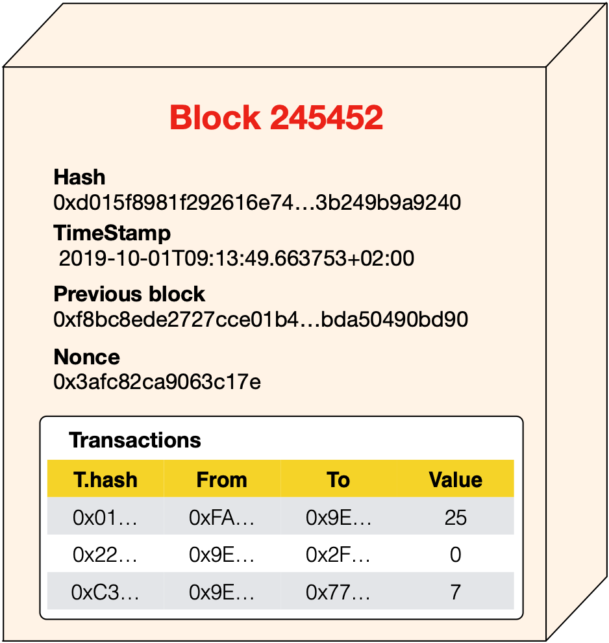
Blocks
T.hash | From | To | Value
0x01… | 0xFA… | 0x9E… | 25
0x22… | 0x9E… | 0x2F… | 0
0xC3… | 0x9E… | 0x77… | 7

Slide 16
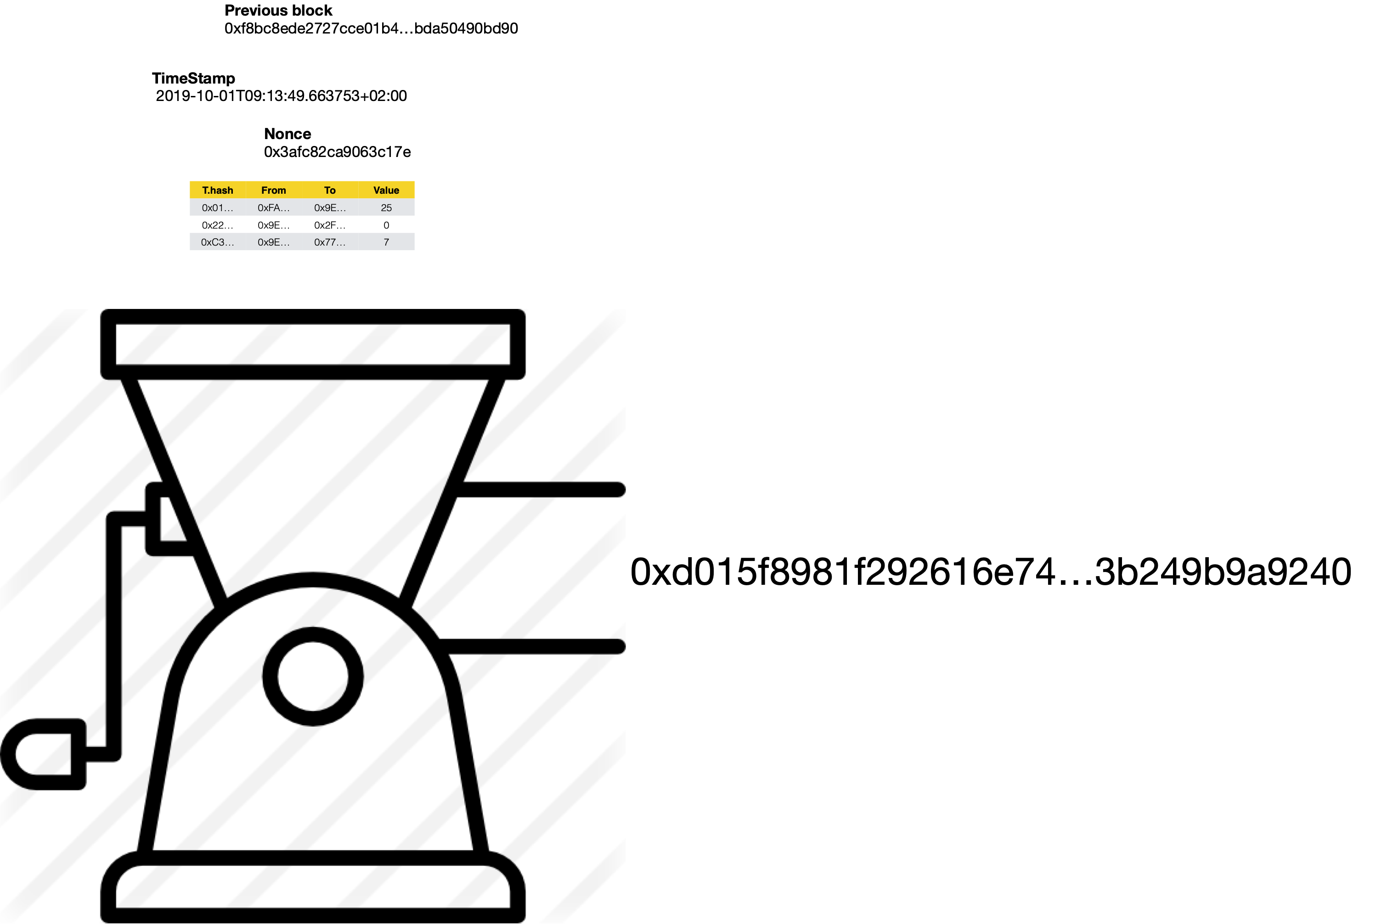

How are the Blocks Linked?

Slide 17
How are the Blocks Linked?
The blocks are linked by a Hash number computed over the body of the block
Previous block’s hash
The timestamp
The transactions
The nonce

Slide 18
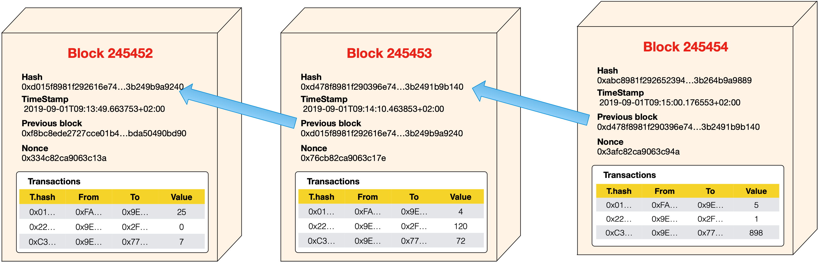
Linking Blocks Example

Slide 19
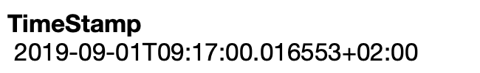
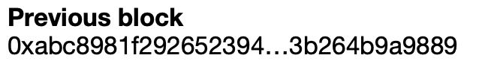
Linking Blocks Example
T.hash | From | To | Value
0x10… | 0xAB… | 0xEE… | 32
0xC2… | 0x89… | 0xF2… | 243
0xD1… | 0xCA… | 0x76… | 1

Slide 20
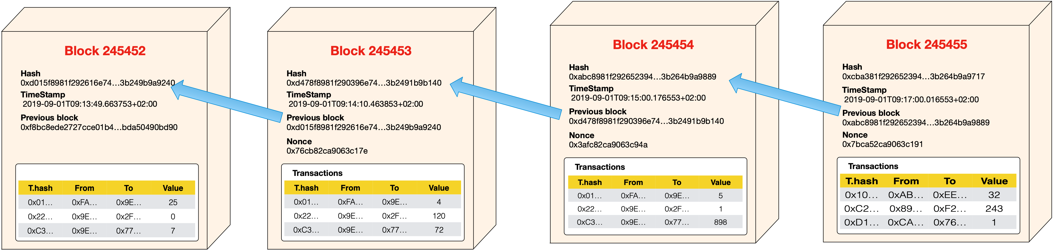
Linking Blocks Example

Slide 21
What if… Someone Tampers the Blocks?
For manually rollback an error
For modify a transaction with malicious intentions

Slide 22
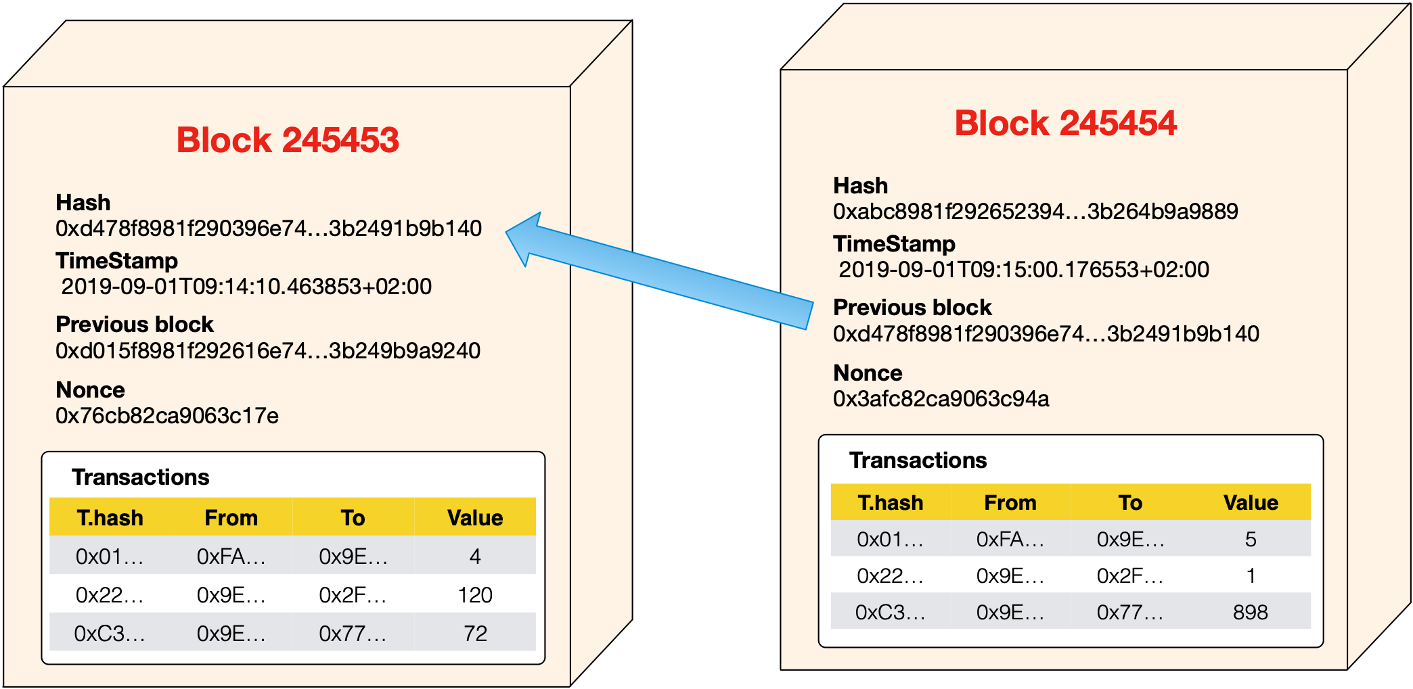
Tampering Blocks

Slide 23
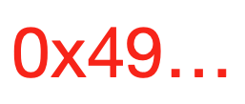
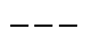
Tampering Blocks

Slide 24
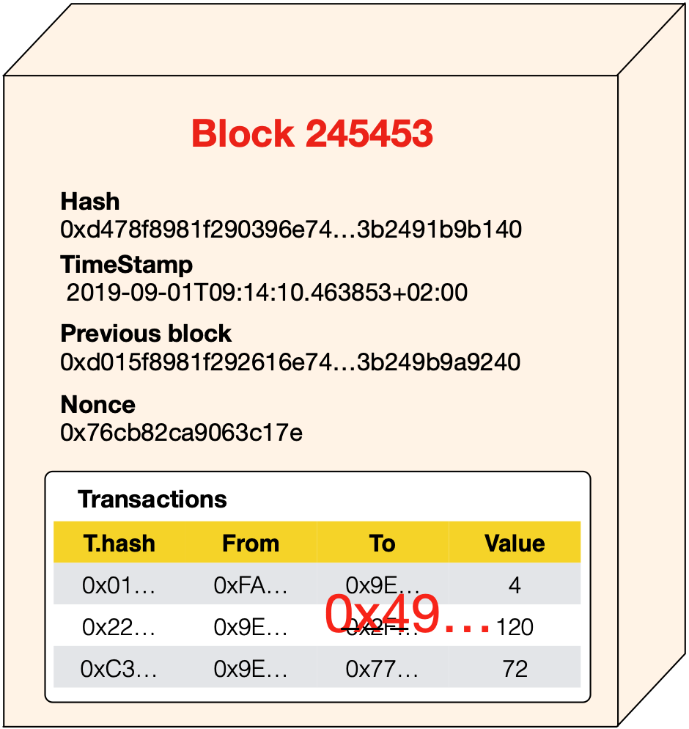
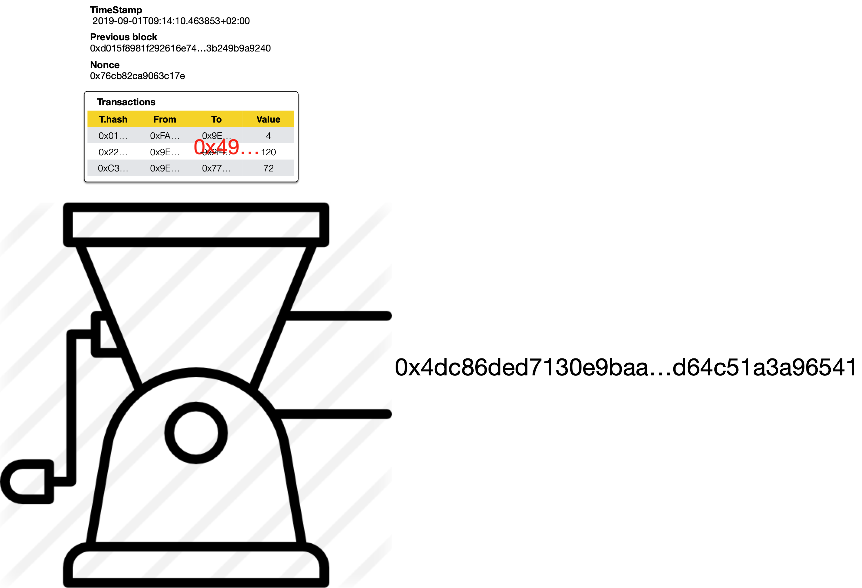

Verification Process

Slide 25
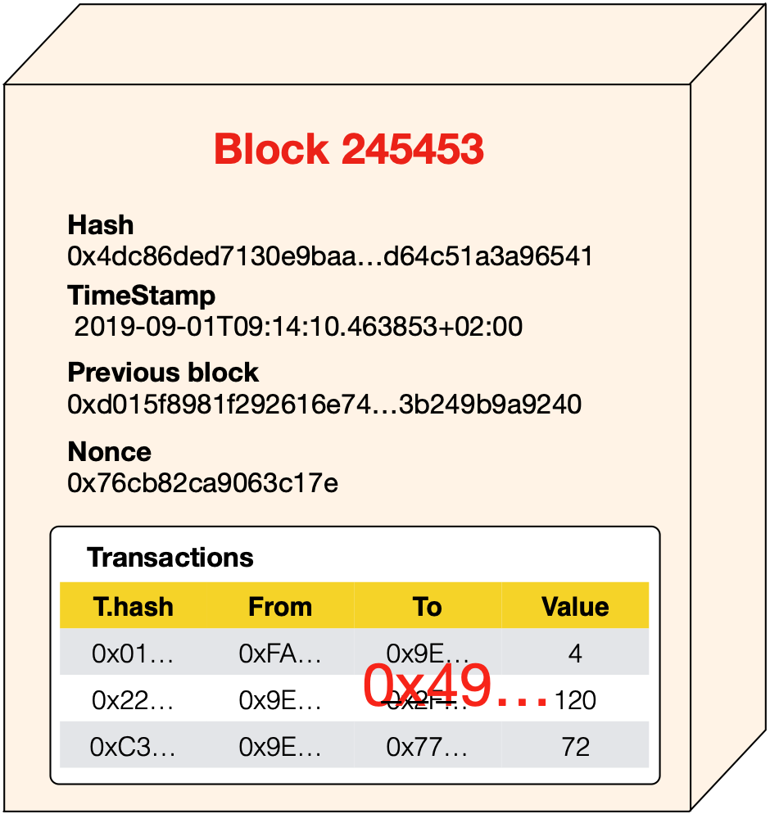
Verification Process

Slide 26
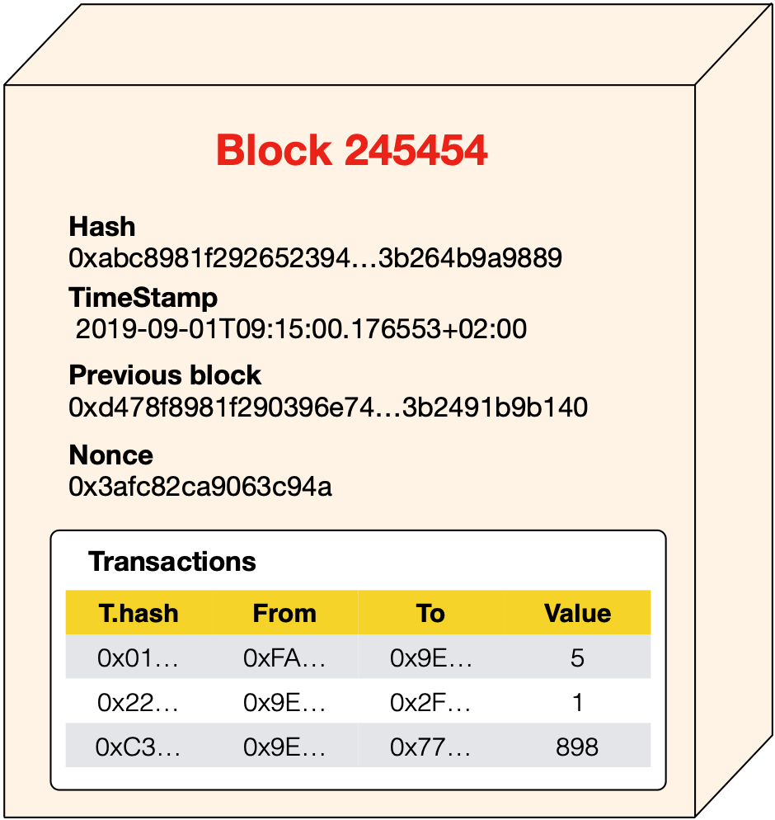
Verification Process

Slide 27
Cool but… what is it good for?
Ensure traceability

Slide 28

Trustless Trust
The transactions/blocks are verified by every node (trustless).
This ensures the approved transactions/block are legit (promoting trust).
And allows entities to interact without a trusted 3rd party.

Slide 29
Mining

Slide 30
Mining
To Mine is the process of creating a valid block and adding it to the blockchain
A Miner is someone who mines the blockchain.
A miner that creates a valid block, earns the right of acquiring a parametrisable amount of cryptocurrency

Slide 31
What is a valid block?

Slide 32
What is a valid block?
One that is accepted by the consensus algorithm of the network

Slide 33
Consensus algorithms
Verify / accept modifications
Ensure that the miner has something to lose

Slide 34
Consensus algorithms
Verify / accept modifications
Verify block hashes
Verify non-double spent
Verify transactions consistency

Slide 35
Consensus algorithms
Ensure that the miner has something to lose
Ensure that the miners do not complot for modifying history
Ensure that the miners do not have parasitic behaviours

Slide 36
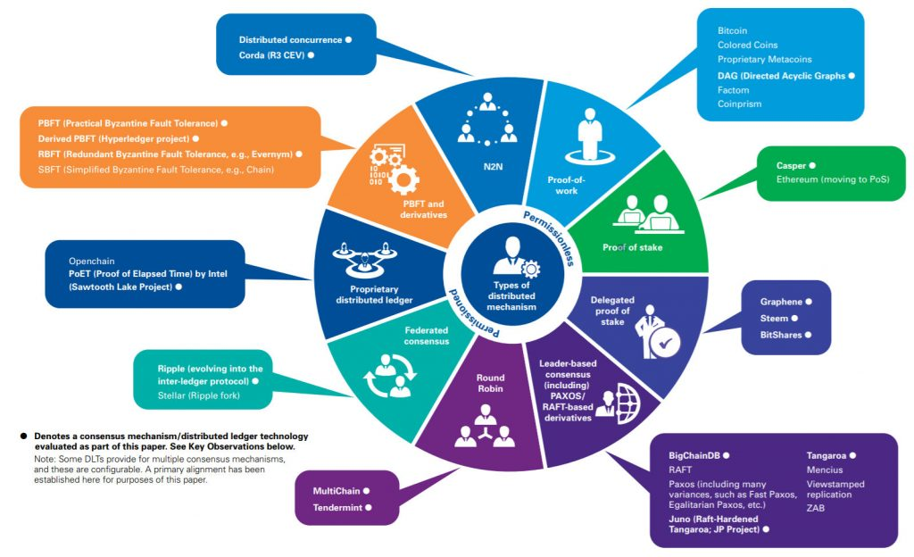

Consensus algorithms

Slide 37
Proof of work
Requires the resolution of a crypto-puzzle
Ensures the economic engagement of the miners
Super high energy consumption

Slide 38
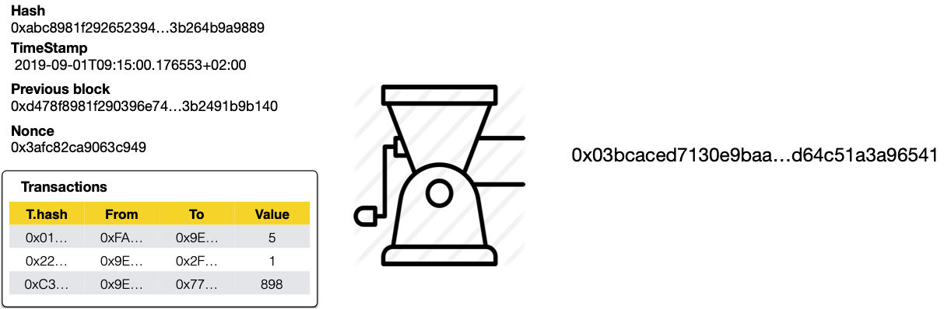
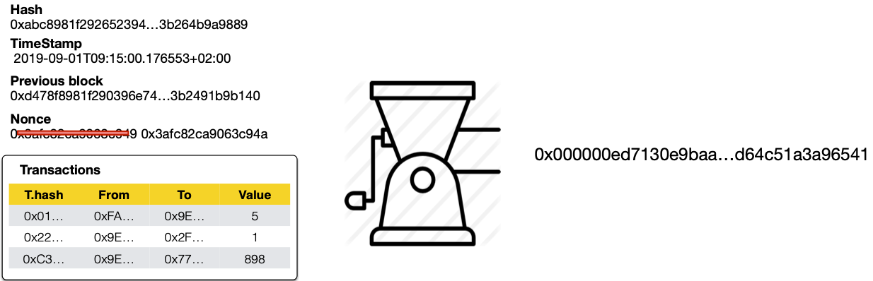
Proof of work: The puzzle

Slide 39
What is a valid blockchain?
The longest chain

Slide 40
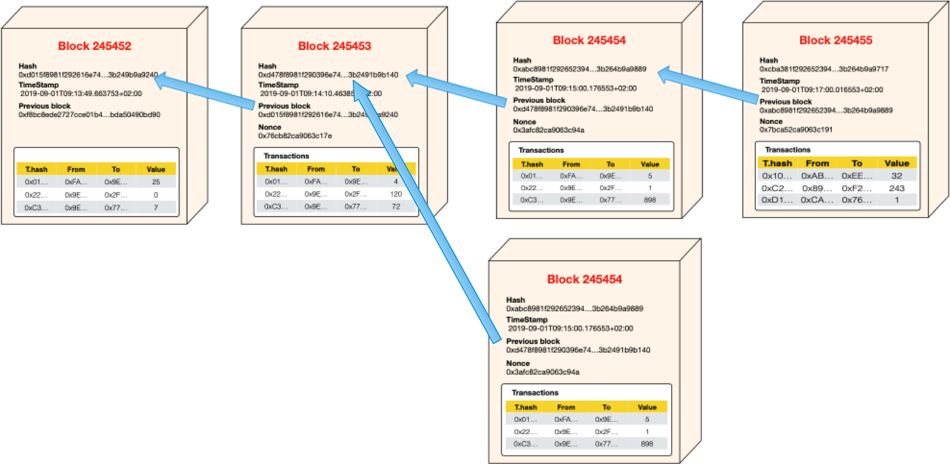
The longest chain

Slide 41
The longest chain
Ensures that tampering is near impossible
Chooses the chain that most of the users is using for

Slide 42
Brief Blockchain

Slide 43
Brief
P2P Open Network
Transactional Append only database
Administrated and surveilled by an engaged community
Rules defined by a consensus algorithm

Slide 44
Smart Contracts

Slide 45

Smart Contracts
[Fritz Henglein, Smart Contracts…, 2017]
“Smart Contracts are neither Smart nor Contracts”
Smart Contracts are self-executing programs coded in complex Turing-complete language.
Rules & Actions intermixed (not a contract)
Low-level programs hard to analyze (not smart)

Slide 46

Smart Contracts
[Ethereum Doc, 2018]
Contracts should not be seen as something that should be “fulfilled” or “complied with”
They are more like “autonomous agents” that live inside the blockchain
Executing a specific piece of code when “poked” by a message or transaction
Have direct control over their cryptocurrency and attributes to store their permanent state.

Slide 47
Contract Ex: Pair Storage

Slide 48
Diagram Contract Interaction

Slide 49
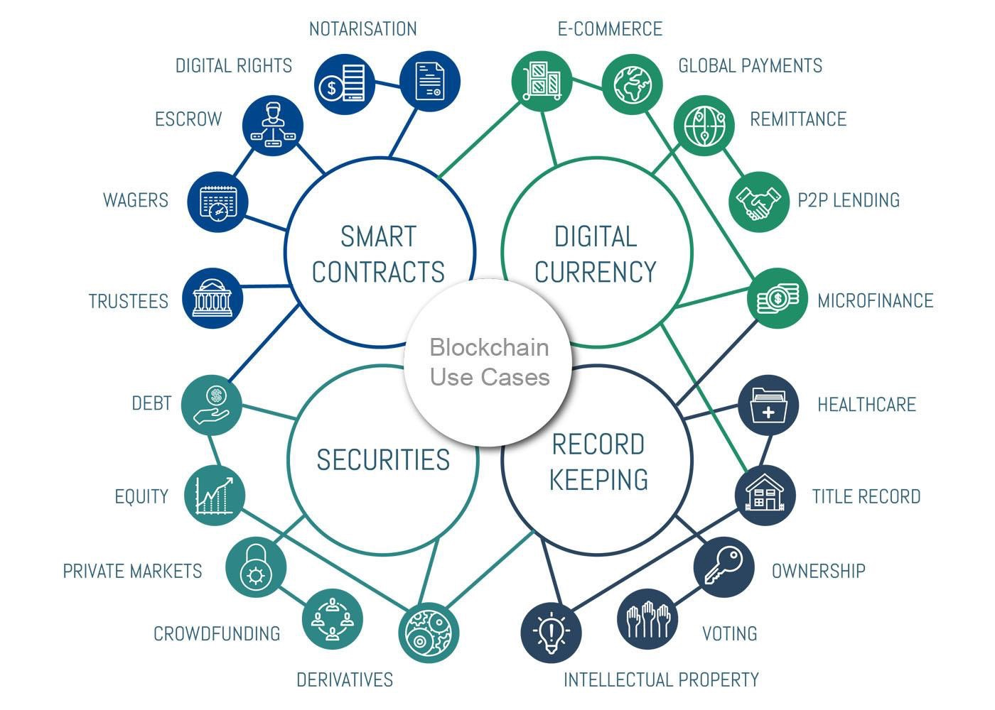
Blockchain Use Cases

Slide 50
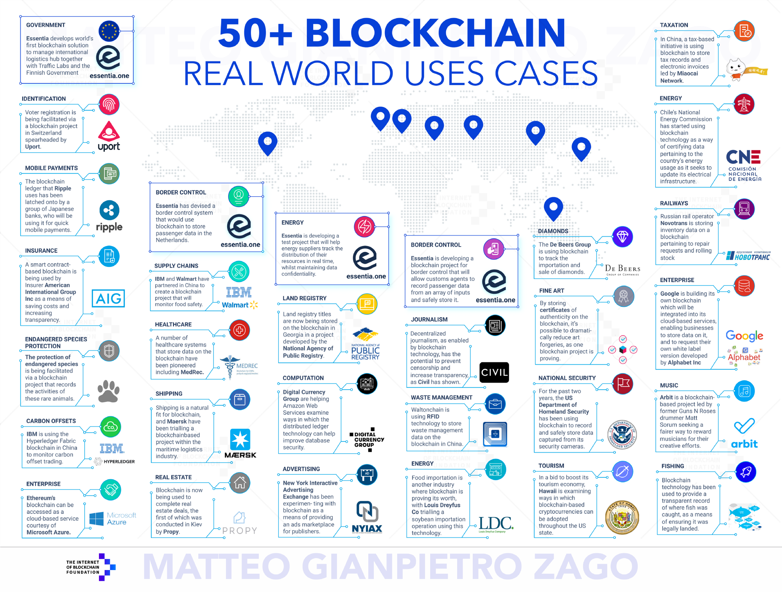

Slide 51
Blockchain Research

Slide 52
Rmod
We welcome any research idea you may have for us.
We are also open to industrial and academic partnerships to advance blockchain research.
<https://github.com/RMODINRIA-Blockchain>
<https://rmod.inria.fr/web>

Slide 53
Rmod
SmartInspect: Contract internal state inspector
EQL: query language for Ethereum blockchain
SmartMetrics: Metric suite for contracts
SolVis: Visualization tool for Solidity contracts
BcModel: Modeling tools
Business process Orchestration

Slide 54
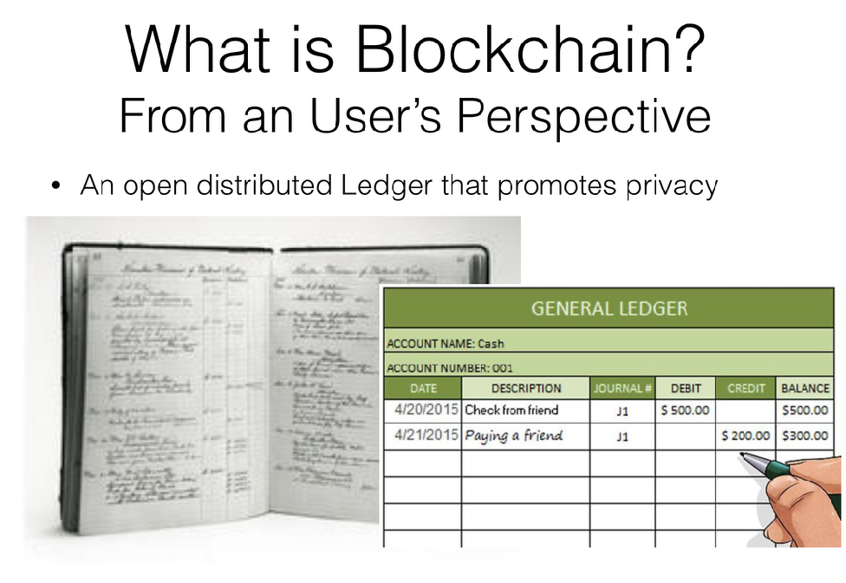
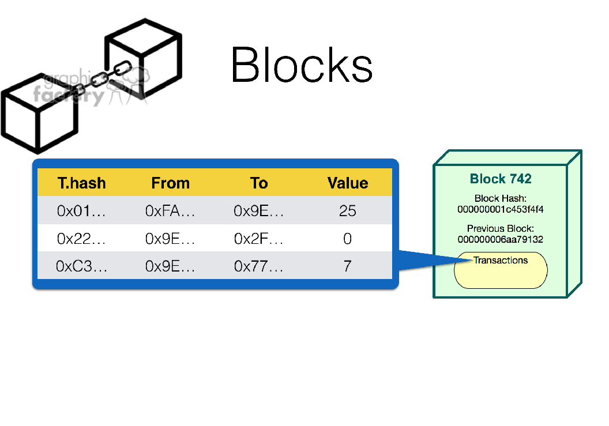
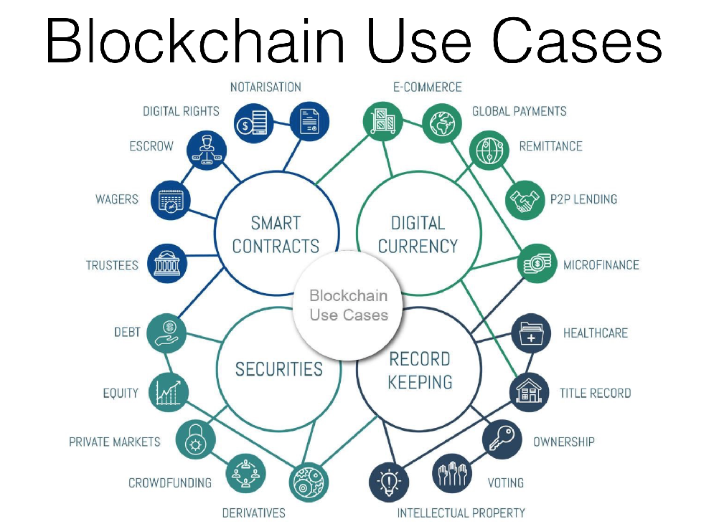
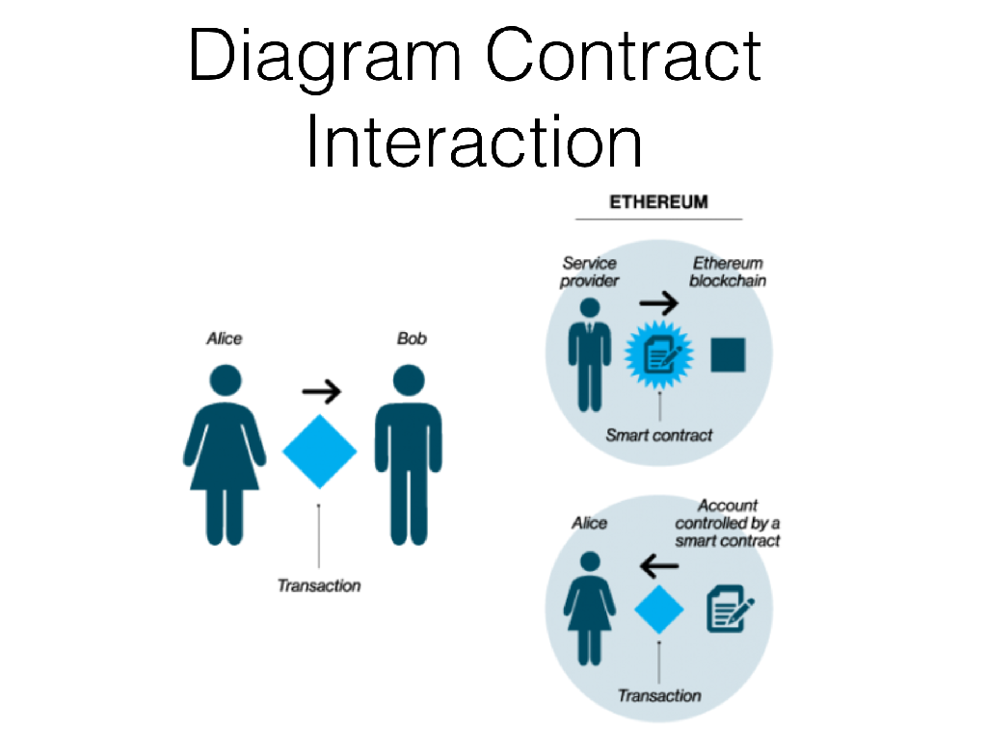
Thanks… questions?

Slide 55
Break :)

